Slide 1
Amazon
Chinmay Arolkar
Shashank Jain
Mayuresh Deodhar
Shreya Mishra
Haroon Syed

Slide 2

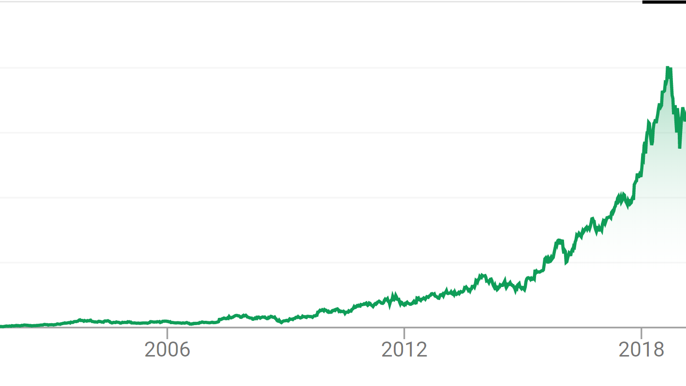

What is Amazon?
Amazon.com is an American multinational technology company based in Seattle, Washington, that focuses on e-commerce, cloud computing, digital streaming, and artificial intelligence.
The company initially started as an online marketplace for books but later expanded in various domain.
The Amazon stock started to grow rapidly after year 2012.

Slide 3

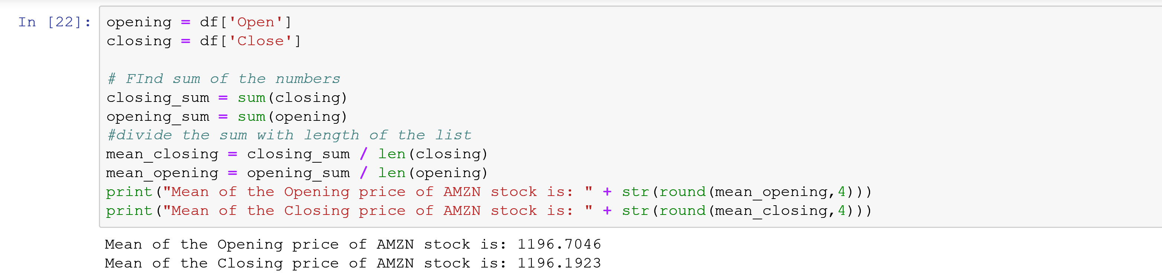
MEan
Mean is just another name for average. To find the mean of a data set, add all the values together and divide by the number of values in the set.

Slide 4
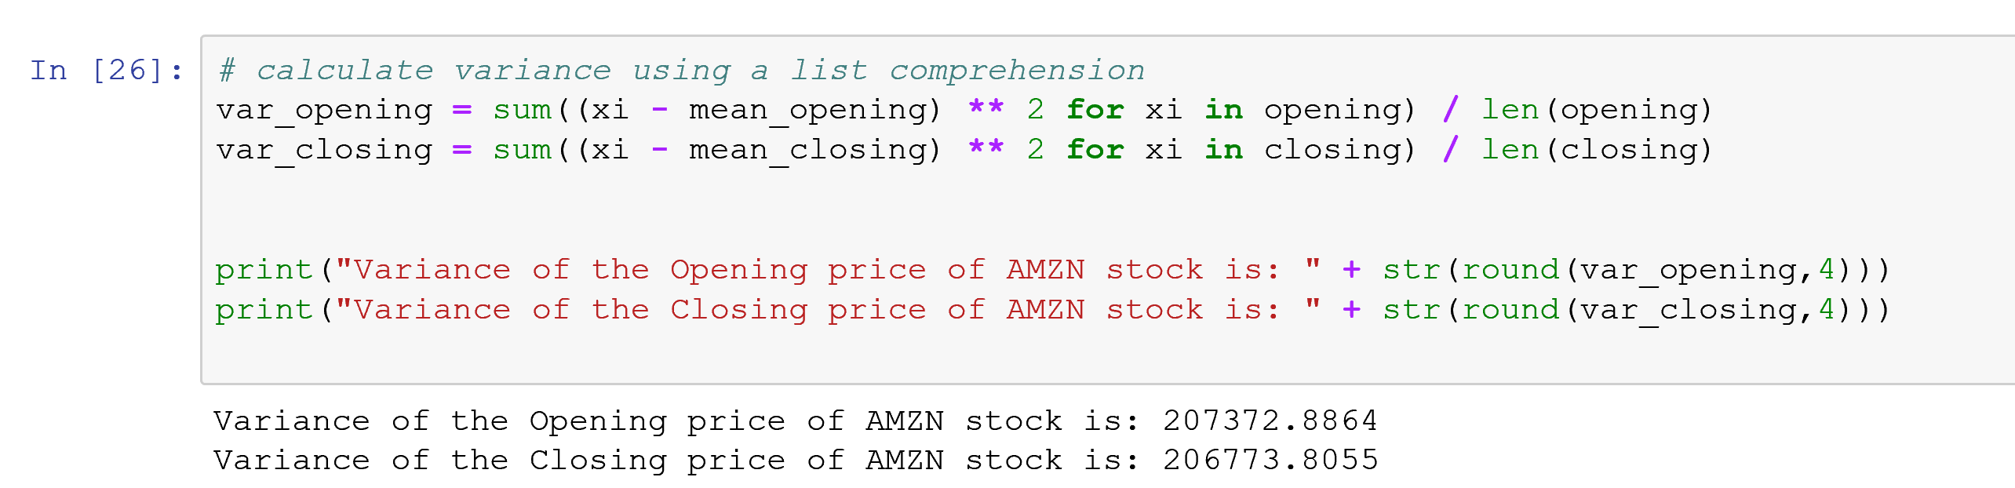
Variance
In probability theory and statistics, variance is the expectation of the squared deviation of a random variable from its mean. Informally, it measures how far a set of (random) numbers are spread out from their average value.

Slide 5
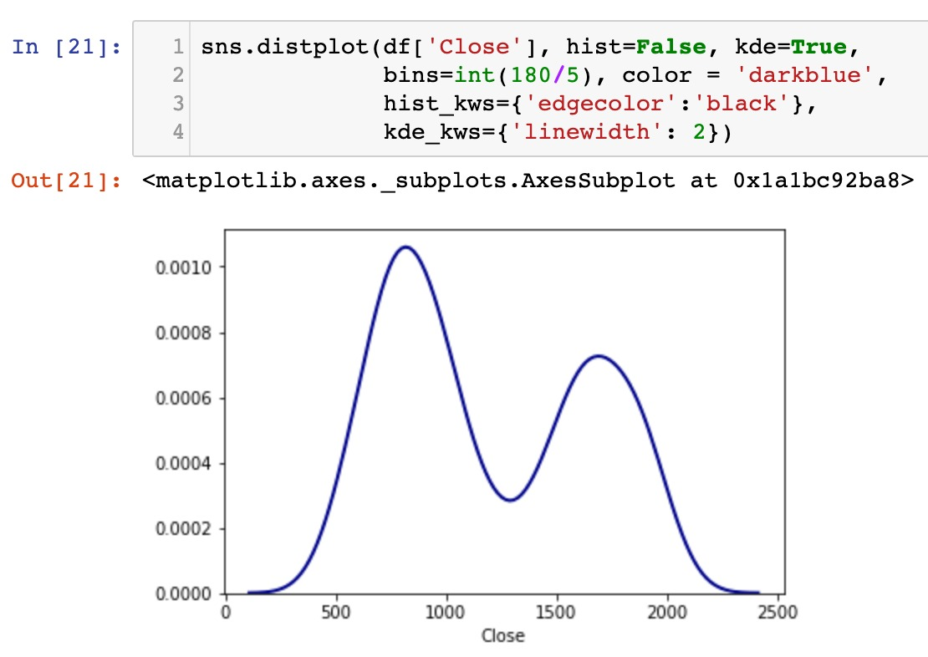
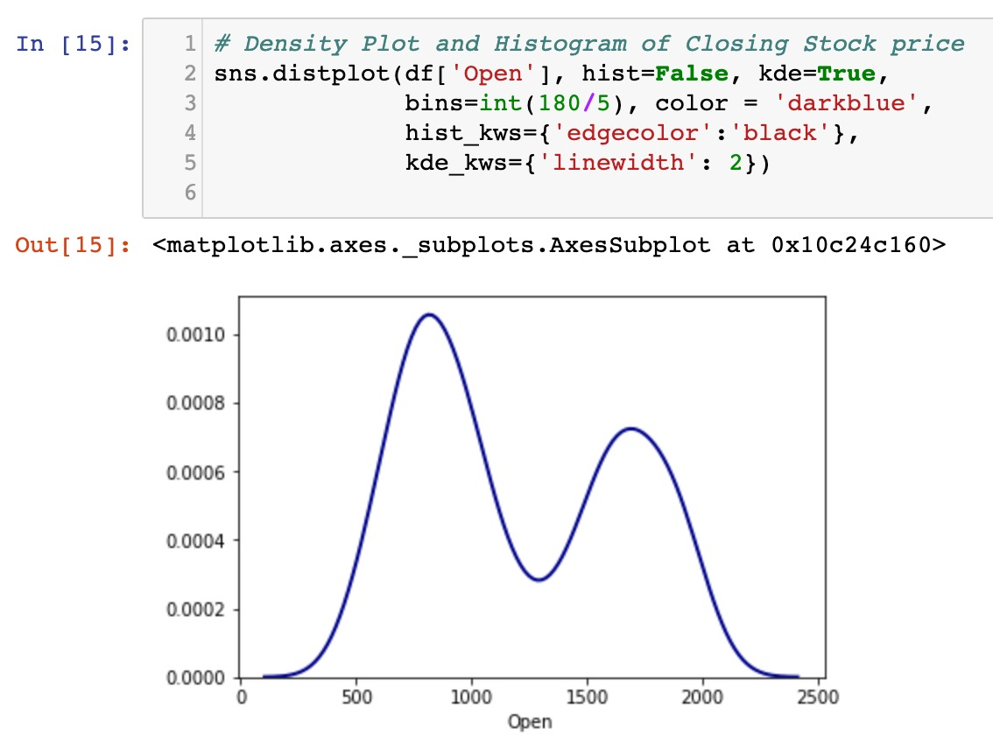
Density Plots

Slide 6
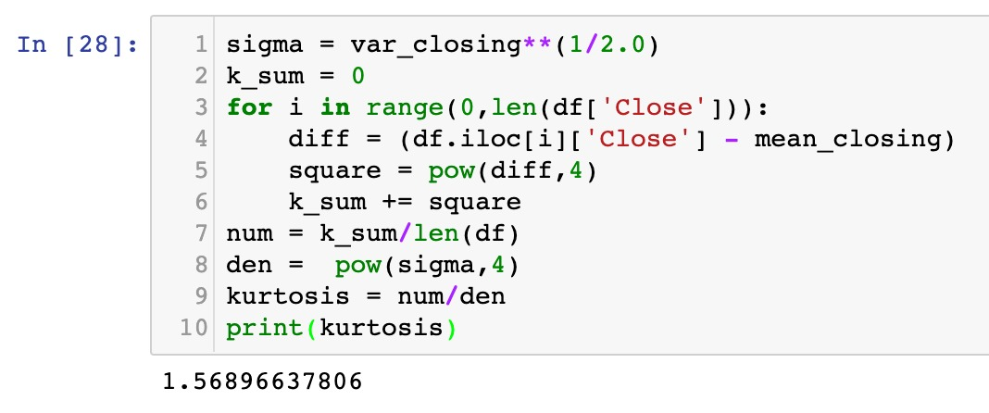
Kurtosis
Kurtosis is a measure of whether the data are heavy-tailed (profusion of outliers) or light-tailed (lack of outliers) relative to a normal distribution.

